Slide 1


Gabriel Pinho
19-mar-2024

Slide 2

Outline
Executive Summary
Introduction
Methodology
Results
Conclusion
Appendix

Slide 3
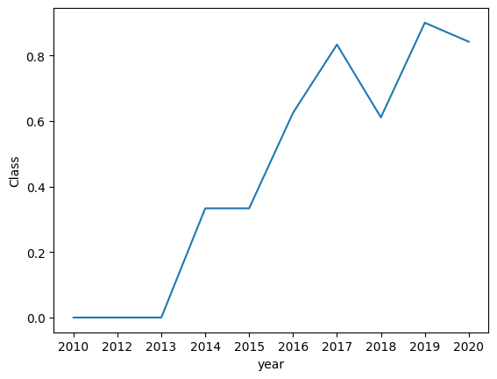
Executive Summary
Summary of methodologies
EDA with SQL
EDA with data visualization
Maps with Folium
DashBoard with Plotly Dash
The main factor of success in launches is the experience gain in the firsts attempts, like we can below:

Slide 4
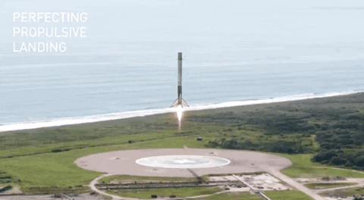
Introduction
Project background and context
SpaceX advertises Falcon 9 rocket launches on its website with a cost of 62 million dollars; other providers cost upward of 165 million dollars each, much of the savings is because SpaceX can reuse the first stage.
Problems you want to find answers
if we can determine if the first stage will land, we can determine the cost of a launch. This information can be used if an alternate company wants to bid against SpaceX for a rocket launch. In this project, we will predict if the Falcon 9 first stage will land successfully

Slide 5

Section 1

Slide 6
Methodology
Executive Summary
Data collection methodology:
Data was collecting using spacex API
Perform data wrangling
Several functions were created to process the data
Perform exploratory data analysis (EDA) using visualization and SQL
Perform interactive visual analytics using Folium and Plotly Dash
Perform predictive analysis using classification models
How to build, tune, evaluate classification models

Slide 7
Data Collection
Data was collecting using spacex API with python library request and the URL https://api.spacexdata.com/v4/launches/past
Several functions were created to process the data, mainly to:
filter only to include Falcon9 launches
Replace null entries in PayloadMass with its mean value
and to transform cathegorical data into numerical ones using one hot encoder (Pandas get_dummies). Details of the functions in the flow chart next slide.

Slide 8
Data Collection – SpaceX API
Notebook with Data Collection
Estudos.IBM_Data_Science/10_Applied_Data_Science_Capstone/notebooks/01_jupyter-labs-spacex-data-collection-api.ipynb at main · gaugustop/Estudos.IBM_Data_Science (github.com)
getBoosterVersion
getLaunchSite
getPayloadData
getCoreData
Filter to only Falcon 9
spacex_url="https://api.spacexdata.com/v4/launches/past"
response = requests.get(spacex_url)
json = response.json()
dataset_part_1.csv
data = pd.json_normalize(json)

Slide 9
Data Collection - Scraping
Notebook with Data Collection
Estudos.IBM_Data_Science/10_Applied_Data_Science_Capstone/notebooks/01_jupyter-labs-spacex-data-collection-api.ipynb at main · gaugustop/Estudos.IBM_Data_Science (github.com)
spacex_url="https://api.spacexdata.com/v4/launches/past"
response = requests.get(spacex_url)
json = response.json()
data = pd.json_normalize(json)

Slide 10
Data Wrangling
Github Link to data Wrangling Jupyter Notebook
Estudos.IBM_Data_Science/10_Applied_Data_Science_Capstone/notebooks/02_labs-jupyter-spacex-Data wrangling.ipynb at main · gaugustop/Estudos.IBM_Data_Science (github.com)
Make ‘class’ column with outcome from landings
dataset_part_1.csv
dataset_part_2.csv

Slide 11
EDA with Data Visualization
Charts ploted (to see if there is correlation between those variables)
Scatter plot: Pay load mass vs Flight Number
Scatter plot: Launch Site vs Flight Number
Scatter plot: Launch Site vs Payload mass
Bar plot: Class vs Orbit
Scatter plot: Orbit vs Flight Number
Scatter plot: Orbit vs Payload mass
Line chart: Class vs Year
Github Jupyter Notebook:
Estudos.IBM_Data_Science/10_Applied_Data_Science_Capstone/notebooks/04_jupyter-labs-eda-dataviz.ipynb at main · gaugustop/Estudos.IBM_Data_Science (github.com)

Slide 12
EDA with SQL
SQL queries performed:
select distinct(Launch_Site) from spacextable
select * from spacextable where Launch_Site like 'CCA%' limit 5
select Customer, sum(PAYLOAD_MASS__KG_) as 'total payload' from spacextable where Customer = "NASA (CRS)“
select distinct(Booster_Version) from spacextable where Booster_Version like 'F9 v1.1%'
select round(avg(PAYLOAD_MASS__KG_),3) from spacextable where Booster_Version like 'F9 v1.1%'
select min(Date) as 'Date of first succesful landing' from spacextable where Landing_Outcome like '%Success%'
select Booster_Version from spacextable where Landing_Outcome = 'Success (drone ship)' and PAYLOAD_MASS__KG_ between 4000 and 6000
select Mission_Outcome, count(Mission_Outcome) as 'Count' from spacextable group by Mission_Outcome
select Booster_Version from spacextable where PAYLOAD_MASS__KG_ = (select max(PAYLOAD_MASS__KG_) from spacextable)
select Date, Booster_Version, Launch_Site, Landing_Outcome, substr(Date, 6, 2) as month from spacextable where Landing_Outcome = 'Failure (drone ship)' and substr(Date,0,5)='2015’
select Landing_Outcome, count(Landing_Outcome) as Count from spacextable group by Landing_Outcome having Date between '2010-06-04' and '2017-03-20' order by Count desc
Add the GitHub URL of your completed EDA with SQL notebook, as an external reference and peer-review purpose

Slide 13
EDA with SQL
Github Jupyter Notebook:
Estudos.IBM_Data_Science/10_Applied_Data_Science_Capstone/notebooks/03_jupyter-labs-eda-sql-coursera_sqllite.ipynb at main · gaugustop/Estudos.IBM_Data_Science (github.com)

Slide 14
Build an Interactive Map with Folium
Interactive maps were created using Folium, a Python Library. In order to better understand the geographic influence in launch success there were added to the maps: markers, marker clusters, distance from coastline and lines.
Github Jupyter Notebook: Estudos.IBM_Data_Science/10_Applied_Data_Science_Capstone/notebooks/05_lab_jupyter_launch_site_location.ipynb at main · gaugustop/Estudos.IBM_Data_Science (github.com)

Slide 15
Build a Dashboard with Plotly Dash
In the Dashboard with Plotly Dash, we have one dropdown to chose the Lauch Site, then a Pie chart showing the successful count per launch site (if one site is chosen then we see the proportion of success/failure of that site). Below that we have a payload mass range the user can chose and a scatter plot with class vs payload mass. This scatter plot also interacts with the dropdown.
Github Python file:
Estudos.IBM_Data_Science/10_Applied_Data_Science_Capstone/app/spacex_dash_app.py at main · gaugustop/Estudos.IBM_Data_Science (github.com)

Slide 16
Predictive Analysis (Classification)
Summarize how you built, evaluated, improved, and found the best performing classification model
The data were splitted into train and test (test size = 20%). For each model, there were created a GridSearch with cv = 10, some parameters were tested and the score was taken with the test set, also a confusion matrix was created for each model.
Some classification models were tested:
Logistic regression
Support Vector Machine
Decision Tree Classifier
K Nearest Neighbors
Github Jupyter Notebook:
Estudos.IBM_Data_Science/10_Applied_Data_Science_Capstone/notebooks/06_SpaceX_Machine_Learning_Prediction_Part_5.jupyterlite.ipynb at main · gaugustop/Estudos.IBM_Data_Science (github.com)

Slide 17
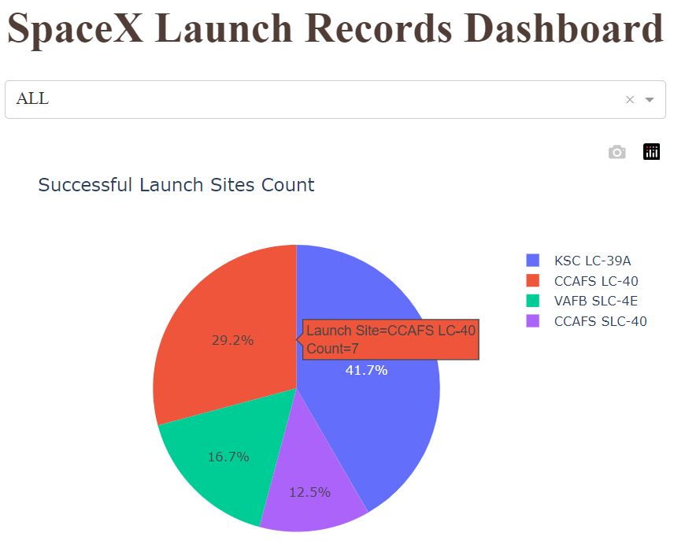
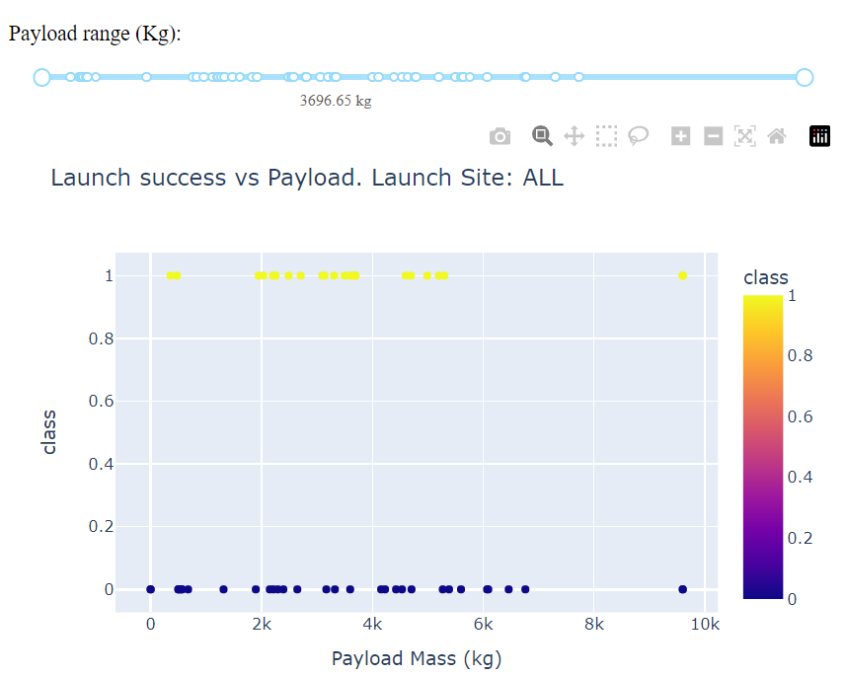
Results
Exploratory data analysis results
Exploratory data analysis shown that we have a correlation between the launch site, number of the flight and payload mass in the success launch
Interactive analytics with Plotly Dash
Predictive analysis results
The best models tested were Logistic Regression, Support Vector Machine and K-Nearest Neighbors

Slide 18

Section 2

Slide 19
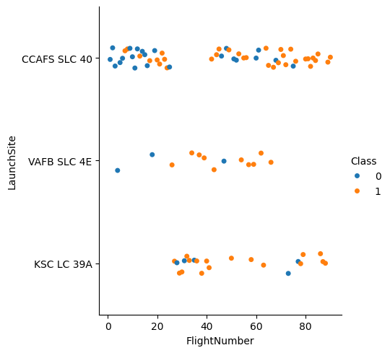
Flight Number vs. Launch Site
Scatter plot of Flight Number vs. Launch Site

Slide 20
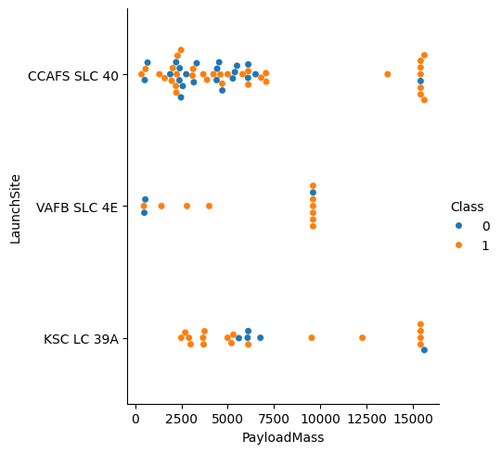
Payload vs. Launch Site
Scatter plot of Payload vs. Launch Site

Slide 21
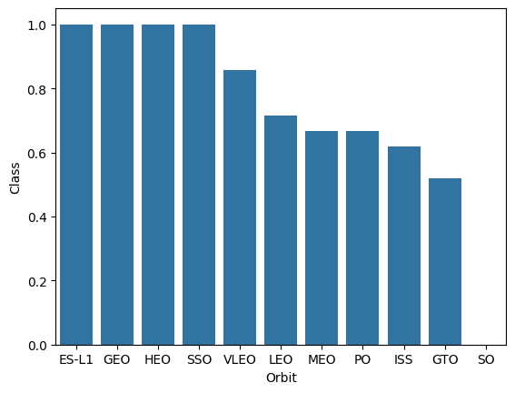
Success Rate vs. Orbit Type
Bar chart for the success rate of each orbit type

Slide 22
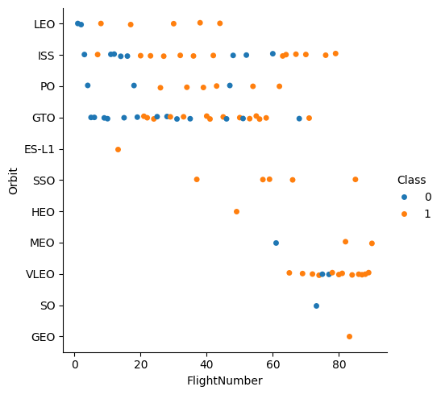
Flight Number vs. Orbit Type
Scatter plot of Flight number vs. Orbit type

Slide 23
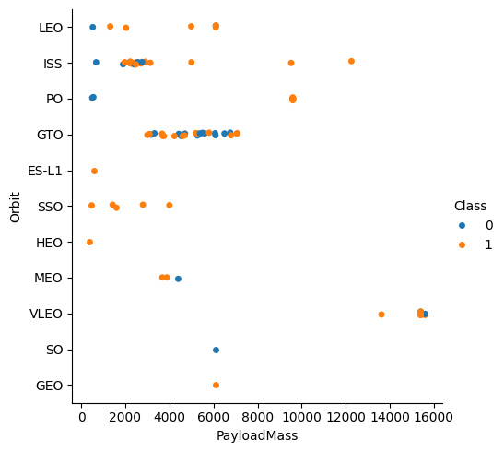
Payload vs. Orbit Type
Scatter plot of payload vs. orbit type

Slide 24
Launch Success Yearly Trend
Line chart of yearly average success rate

Slide 25
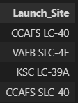
All Launch Site Names
Names of the unique launch sites
select distinct(Launch_Site) from spacextable

Slide 26
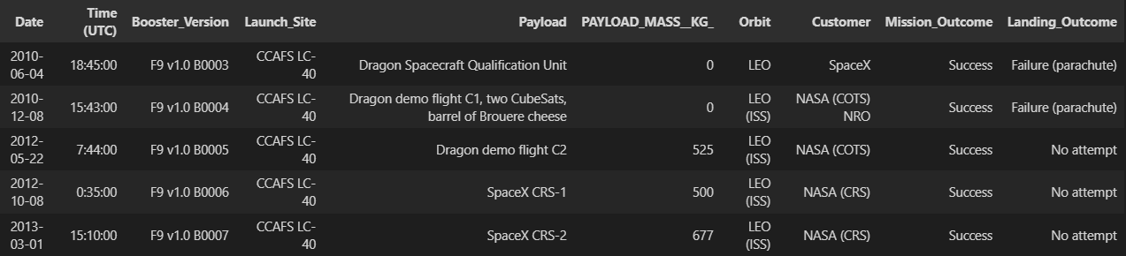
Launch Site Names Begin with 'CCA'
5 records where launch sites begin with `CCA`
select * from spacextable where Launch_Site like 'CCA%' limit 5

Slide 27
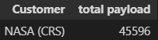
Total Payload Mass
Calculate the total payload carried by boosters from NASA
select Customer, sum(PAYLOAD_MASS__KG_) as 'total payload' from spacextable where Customer = "NASA (CRS)"

Slide 28
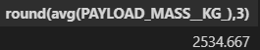
Average Payload Mass by F9 v1.1
Calculate the average payload mass carried by booster version F9 v1.1
select round(avg(PAYLOAD_MASS__KG_),3) from spacextable where Booster_Version like 'F9 v1.1%'

Slide 29
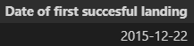
First Successful Ground Landing Date
Find the dates of the first successful landing outcome on ground pad
select min(Date) as 'Date of first succesful landing' from spacextable where Landing_Outcome like '%Success%'

Slide 30
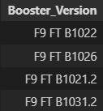
Successful Drone Ship Landing with Payload between 4000 and 6000
List the names of boosters which have successfully landed on drone ship and had payload mass greater than 4000 but less than 6000
select Booster_Version from spacextable where Landing_Outcome = 'Success (drone ship)' and PAYLOAD_MASS__KG_ between 4000 and 6000

Slide 31
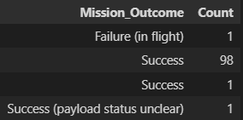
Total Number of Successful and Failure Mission Outcomes
Calculate the total number of successful and failure mission outcomes
select Mission_Outcome, count(Mission_Outcome) as 'Count' from spacextable group by Mission_Outcome

Slide 32
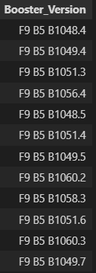
Boosters Carried Maximum Payload
List the names of the booster which have carried the maximum payload mass
select Booster_Version from spacextable where PAYLOAD_MASS__KG_ = (select max(PAYLOAD_MASS__KG_) from spacextable)

Slide 33
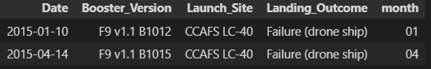
2015 Launch Records
List the failed landing_outcomes in drone ship, their booster versions, and launch site names for in year 2015
select Date, Booster_Version, Launch_Site, Landing_Outcome, substr(Date, 6, 2) as month from spacextable where Landing_Outcome = 'Failure (drone ship)' and substr(Date,0,5)='2015'

Slide 34
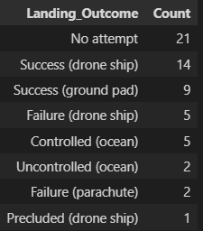
Rank Landing Outcomes Between 2010-06-04 and 2017-03-20
Rank the count of landing outcomes (such as Failure (drone ship) or Success (ground pad)) between the date 2010-06-04 and 2017-03-20, in descending order
select Landing_Outcome, count(Landing_Outcome) as Count from spacextable group by Landing_Outcome having Date between '2010-06-04' and '2017-03-20' order by Count desc

Slide 35

Section 3

Slide 36
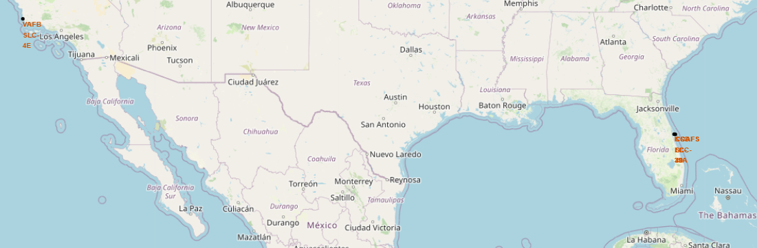
Launch sites map

Slide 37
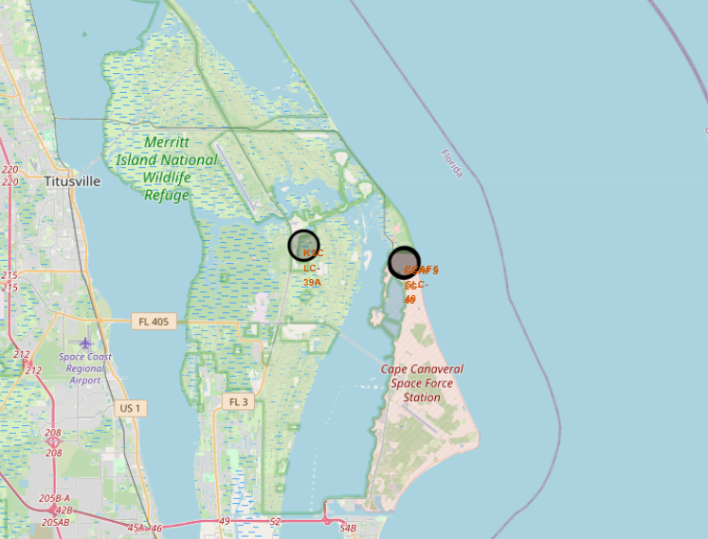
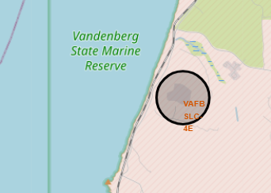
Launch sites map

Slide 38
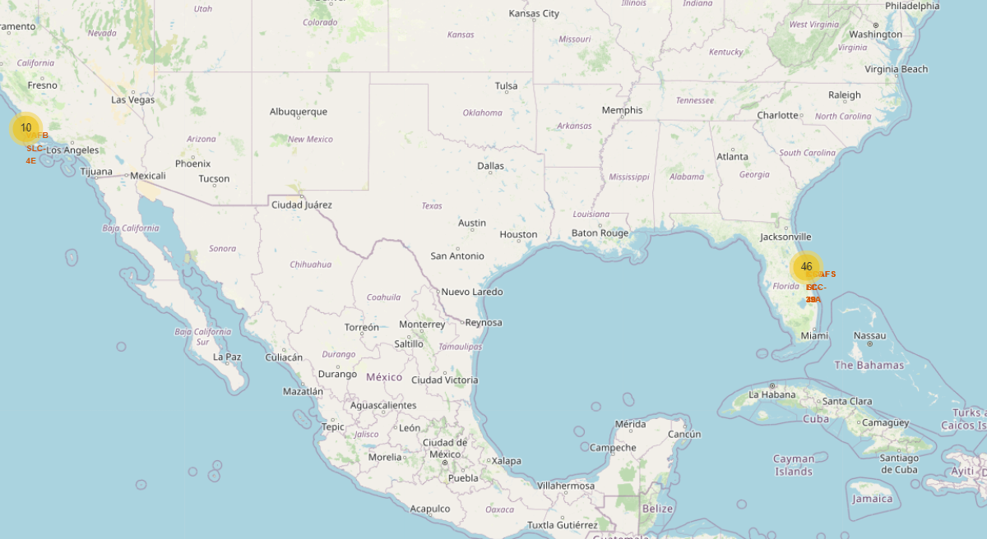
Launch Sites with outcomes

Slide 39
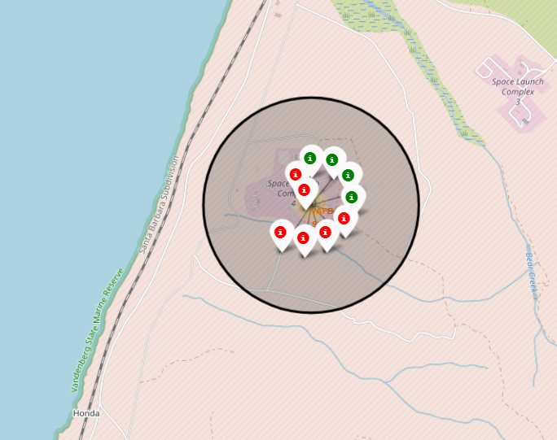
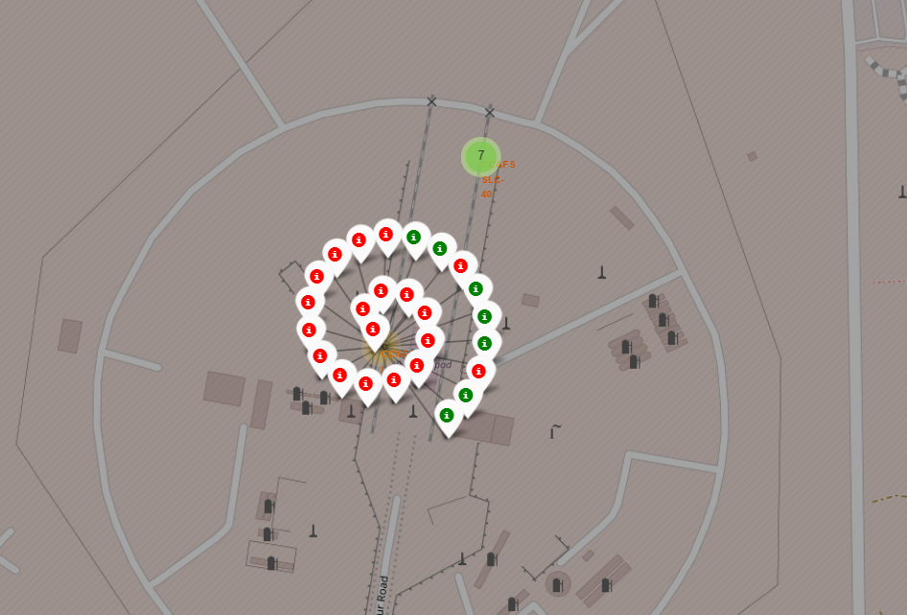
Launch Sites with outcomes

Slide 40
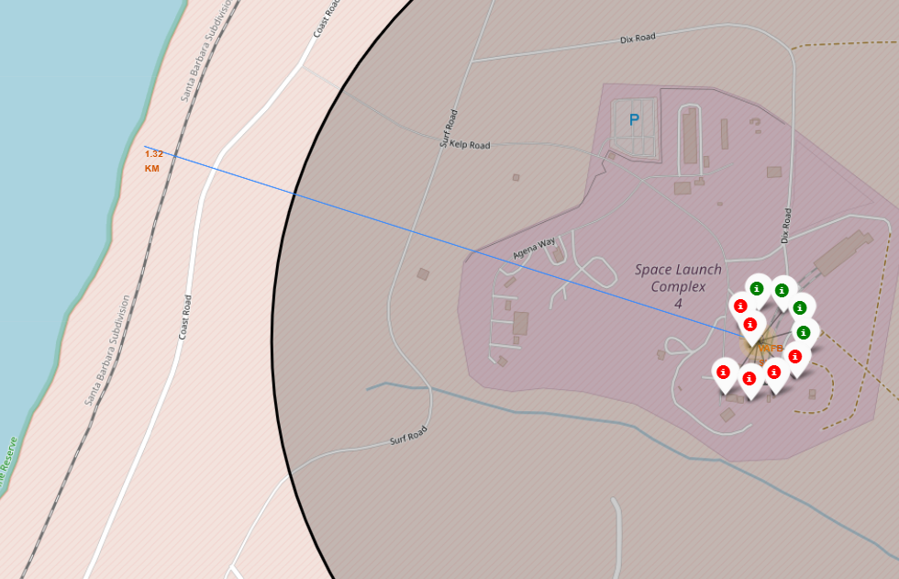
Distance from coastline
1.32 km

Slide 41

Section 4

Slide 42
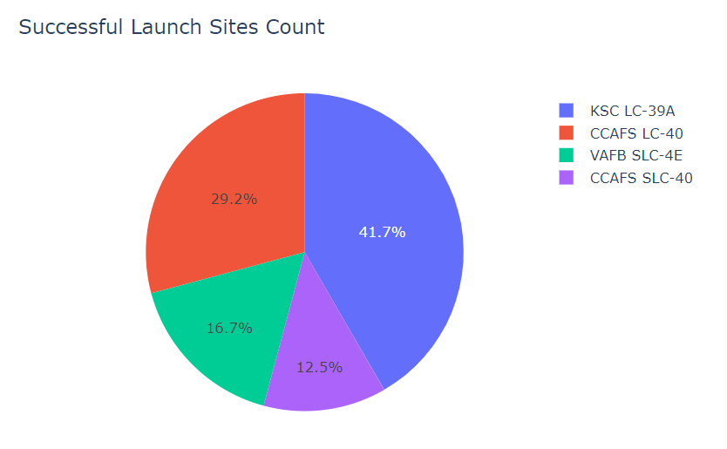
Successful Launch Sites Count

Slide 43
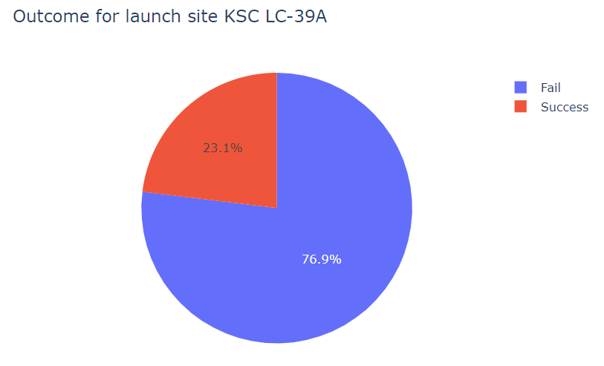
Outcome for launch site with highest success rate

Slide 44
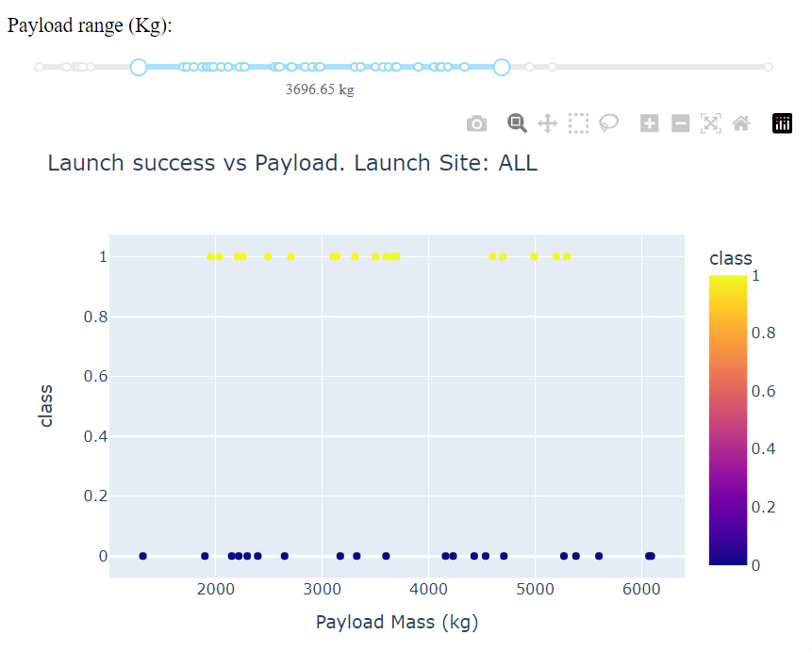
Payload Mass vs Launch outcome (all sites)

Slide 45

Section 5

Slide 46
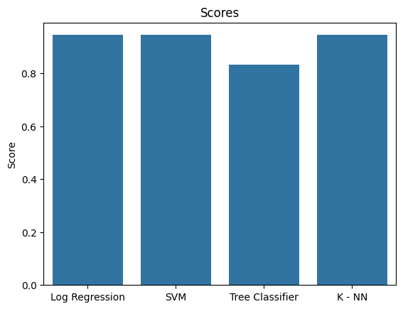
Classification Accuracy
Visualize the built model accuracy for all built classification models, in a bar chart
Find which model has the highest classification accuracy: Log Reg, SVM and KNN

Slide 47

Confusion Matrix
Show the confusion matrix of the best performing model with an explanation

Slide 48
Conclusions
The main factor of success in launches is the experience gain in the firsts attempts, we can see that in slide 24:

Slide 49


